Slide 1

INSTITUTE :UIE
DEPARTMENT: ACADEMIC UNIT 1 - 5
Bachelor of Engineering (EE Branch)
Subject Name and Code:
Engineering Physics 23SPH-141
Prepared by: Divya, Assistant Prof. Physics
i
Superconductivity
DISCOVER . LEARN . EMPOWER

Slide 2

COURSE OBJECTIVES
The course is designed to make the students industry ready to contribute in the growing demand of the industry at local, national and international level.
It will make the students competent to understand basic concepts and applications of advanced engineering physics and apply its principles in their respective fields at global platform.
It will enhance the skill level of the students and shall make them preferred choice for getting employment in industry and research labs.
It will give thorough knowledge of the discipline to enable students to disseminate knowledge in pursuing excellence in academic areas.

Slide 3
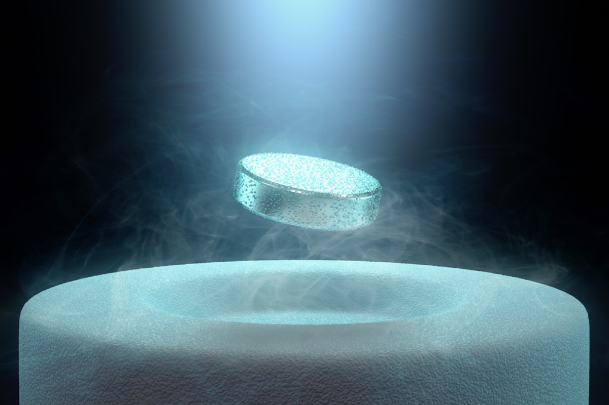
COURSE OUTCOMES
CO Number | Title On completion of this course, the students are expected to learn | Level
CO1 | To identify various components of laser and optical fibers and justify their importance and applications in different fields of science and technology | Understand Applying
CO2 | The basic concepts of semiconductor physics, illustrate the working of various semiconductor components and use its principles in design of optoelectronic devices and its applications. | Understand Applying Analyze
CO3 | To understand the principles of superconductivity and their applications. To illustrate the propagation of em waves. | Understand Applying
Fig. 1 Introduction [1]

Slide 4

Content
Meissner effect
Effect of magnetic field on superconductors.

Slide 5
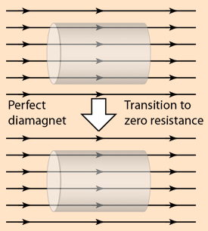
Perfect diamagnet
If a conductor already had a steady magnetic field through it and was then cooled through the transition to a zero- resistance state, becoming a perfect diamagnet, the magnetic field would be expected to stay the same.
Fig.3

Slide 6
History
German researchers Walther Meissner and Robert Ochsenfeld (above) discovered that a superconducting material will repel a magnetic field (below graphic). A magnet moving by a conductor induces currents in the conductor. This is the principle on which the electric generator operates. But, in a superconductor the induced currents exactly mirror the field that would have otherwise penetrated the superconducting material - causing the magnet to be repulsed. This phenomenon is known as strong diamagnetism and is today often referred to as the "Meissner effect" (an eponym). The Meissner effect is so strong that a magnet can actually be levitated over a superconductive material.

Slide 7
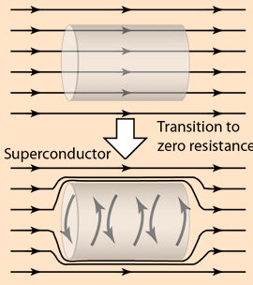
Superconductor
Remarkably, the magnetic behavior of a superconductor is distinct from perfect diamagnetism. It will actively exclude any magnetic field present when it makes the phase change to the superconducting state.
Fig.4

Slide 8
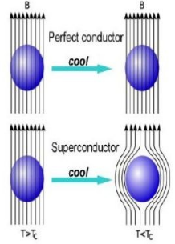
Meissner effect
When a superconducting material at temperature T>Tc is placed in certain magnetic field, lines of magnetic induction pass through its body.
But when it is cooled below critical temperature i.e., T<Tc, these lines of induction are pushed out of the superconducting body. So inside the Superconducting body, B=0.
This is known as Meissner Effect
Fig.2

Slide 9
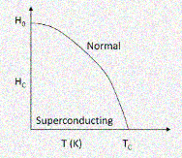
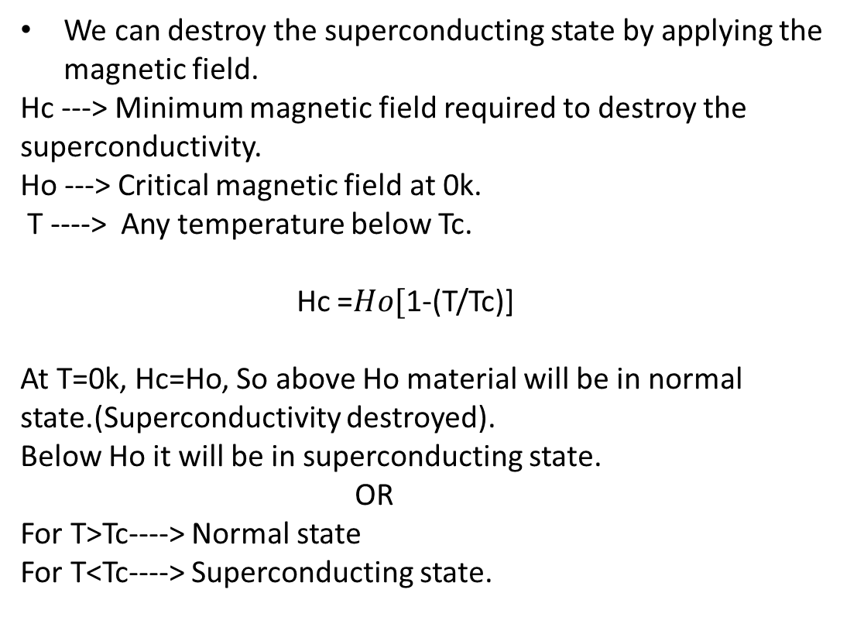
Effect of magnetic field on superconductors
We can destroy the superconducting state by applying the magnetic field.
Hc ---> Minimum magnetic field required to destroy the superconductivity.
Ho ---> Critical magnetic field at 0k.
T ----> Any temperature below Tc.
Hc =$Ho[$1-(T/Tc)]
At T=0k, Hc=Ho, So above Ho material will be in normal state.(Superconductivity destroyed).
Below Ho it will be in superconducting state.
OR
For T>Tc----> Normal state
For T<Tc----> Superconducting state.

Slide 10
Summary
Perfect diamagnet.
Understanding of Meissener effect.
Effect of magnetic field on Superconductor

Slide 11

FAQs
What is diamagnetism?
What do you understand by Meissener effect?
What is Critical magnetic field?
What is effect of magnetic field on behaviour of superconductor?

Slide 12
ASSESSMENT PATTERN
MST(02)
20 marks
Quiz
4 marks
Attendance
(>90%)
2 marks
Surprise test
4 marks
Assignment
10 marks

Slide 13
Reference books and weblinks
https://en.wikipedia.org/wiki/Meissner_effect#:~:text=The%20Meissner%20effect%20(or%20Meissner,cooled%20below%20the%20critical%20temperature.&text=The%20Meissner%20state%20breaks%20down,magnetic%20field%20is%20too%20strong.
http://www.phy.cuhk.edu.hk/djwang/teachlab/old%20material/Lecture%20notes/11QP_ch3.pdf
https://www.electrical4u.com/meissner-effect/#:~:text=This%20effect%20of%20superconductivity%2C%20is,above%20magnet%20or%20vise%2Dversa.

Slide 14
Reference Video links
https://www.youtube.com/watch?v=iUETu0b-E1s
https://www.youtube.com/watch?v=Qt4MmiplvSs

Slide 15
THANK YOU
divya.e8645@cumail.in

